Slide 1
Project 3 Visualization Track Presentation
Chris Kellam, Eric Lidiak, Jason Britton, Matthew Smith, Molly Fox

Slide 2
Project Summary
TOPIC: Public Demonstrations Post Covid
DESCRIPTION
Create a dashboard to visualize various categories of public demonstrations in the post-COVID United States.
RESEARCH QUESTIONS
What types of public demonstration events have occurred post-COVID in the US?
When are these events occurring?
Where are these events occurring?
What portion of the events were peaceful?
How many fatalities were there?

Slide 3
Data and Delivery
Datasets
ACLED (Armed Conflict Location and Event Data): acleddata.com
States Data: https://leafletjs.com/examples/choropleth/
The dashboard utilizes information from a SQL database created from the original comma delimited dataset download subsequent to ETL.
This process utilized a PostgreSQL adapter Python library called "Psycopg".

Slide 4
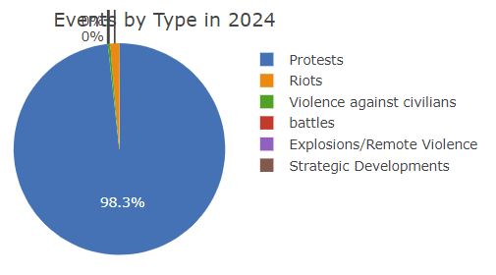
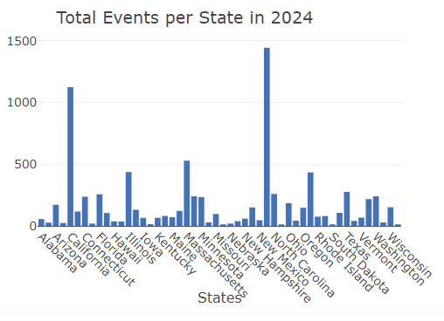
Visualizations
Event Types Distribution
Total Events by State

Slide 5
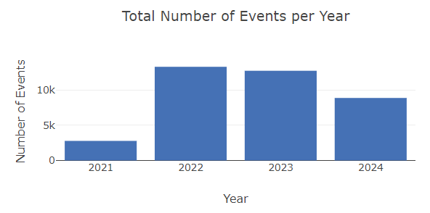
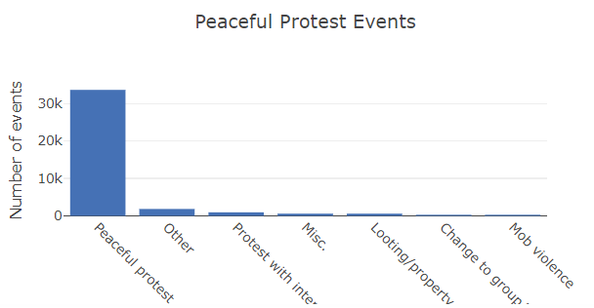
Visualizations
Events Per Year
Peaceful Protests

Slide 6
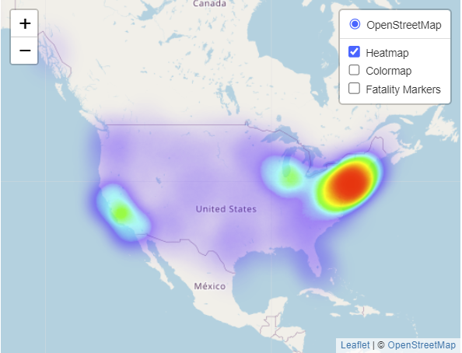
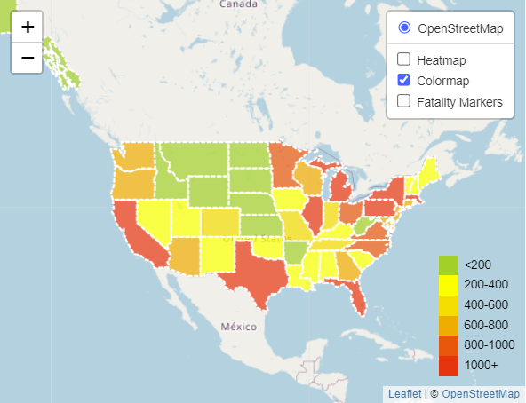
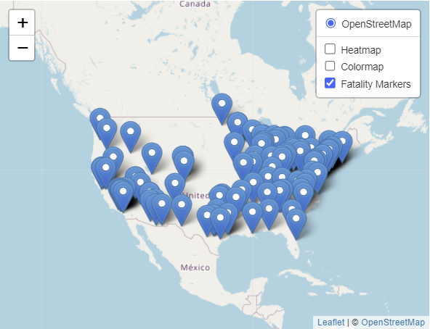
Visualizations
Heatmap Layer
Colormap Layer
Marker Layer

Slide 7
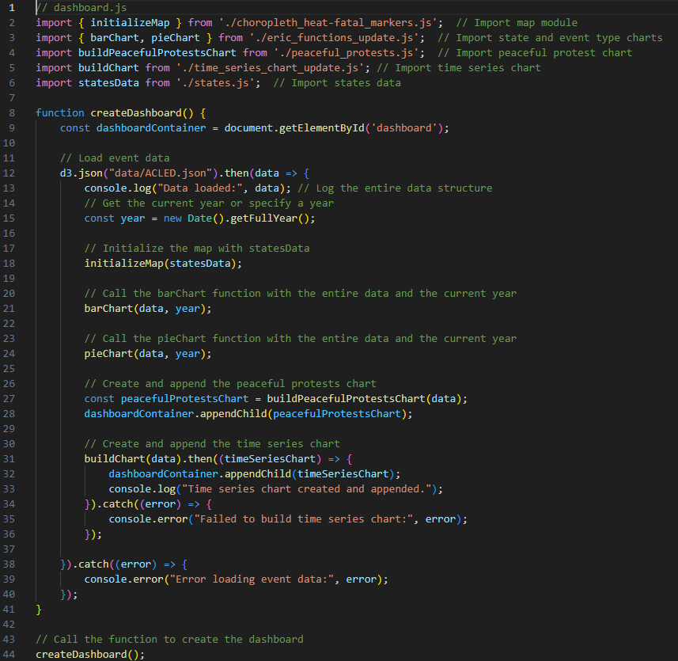
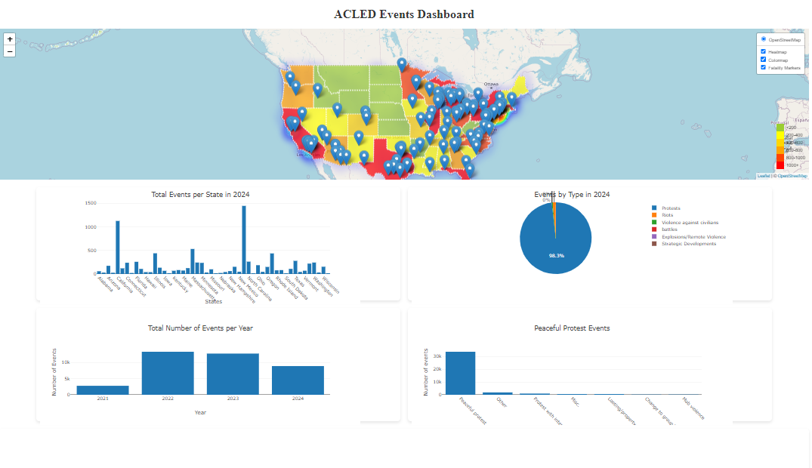
Dashboard
https://jcbritton.github.io/Project3/

Slide 8
Ethical Considerations
TBD - At least one paragraph summarizing efforts for ethical considerations made in the project

Slide 9
Key Observations
Protests are the primary public demonstration type
California and New York have the highest number of demonstrations
Demonstrations have been declining slightly since COVID
The number of peaceful protests is far greater than non-peaceful
Public demonstrations increase around populated areas
Coastal states tend to have a higher number of demonstrations
Fatalities tend to cluster around states with 600+ demonstrations

Slide 10
Thank You

